Slide 1
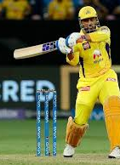
IpL Data Analysis
Done By: -
MTV Soumith (2010030097)
C.Koushik Reddy (2010030027)
D.Chaitanya (2010030045)
Group No:- 9
KLH University

Slide 2
Table of Contents
Project Area
Literature survey
Problem Statement
Motivation
Data Set
Methodologies and tools
Conclusion
References

Slide 3
Project Area
We are going to use machine learning algorithms to set the matter of predicting match results supported historical matches information.
ML is used to predict the match result variable by developing classification models based on certain freelance variables like player’s position, their batting and bowling performances, weather, location, etc.

Slide 4
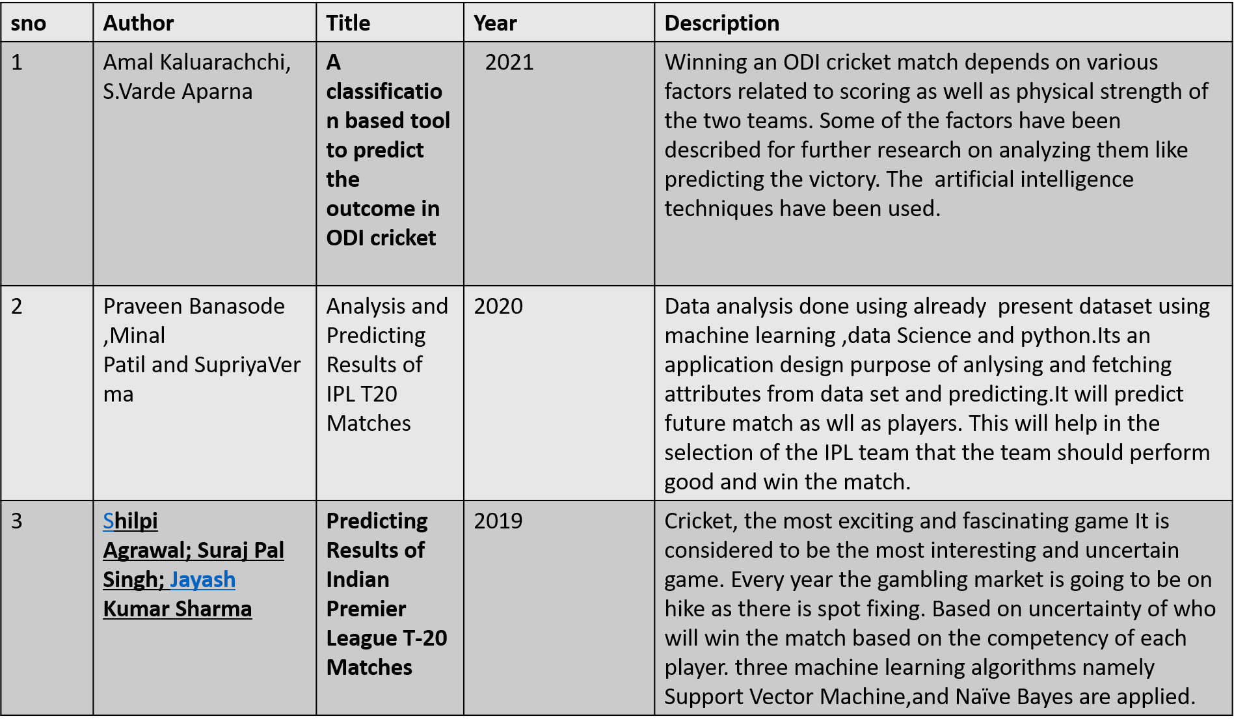
Literature Survey

Slide 5
Problem Statement
In this analysis of IPL matches from 2008 to 2021 is done using python packages like pandas, matplotlib and seaborn.
This Exploratory Data Analysis will help us to find patterns in data, determining relationships in data.
We will try to identify the team that has more chance to win the upcoming seasons by finding observations like success rate of each team, identify the team that has won maximum seasons, best defending and chasing team and analyse the toss decisions etc.

Slide 6
Motivation
Have you ever wonder what happened in the first ball of IPL and which team scored most sixes in each IPL season. We are going to Visualize the IPL Data to clear all your doubts.
IPL has a major fanbase. The first thing many youngsters remember when they hear about IPL is Dream11.
People often Pick their team in dream11 and if that team wins the game they win money.
So, creating a prediction model based on the past IPL data will help the Dream11 users / any other apps users where u bet on a team. So, this is one of our motive for selecting IPL Data Analysis project.

Slide 7
Data Set
We have collected the dataset from Kaggle and many other sources.
Our dataset consists of 194354 rows and 21 columns.
We have performed data pre-processing steps to clean the data.

Slide 8
Methodologies and tools
Data Collection.
Data pre-processing.
Data Visualization based on query.
Python (for prediction models).
Power bi for visualization.

Slide 9
What we are going to analyse..?
Season wise IPL matches.
Most matches Played in a venue.
Matches won by each team.
IPL matches played by each team.
Most runs scored by IPL team and players.
Average runs by teams in powerplay.
Most Century and fifty's by each player.
Most 4’s and 6’s by team and player.
Highest Individual score by player.
Most wickets taken by player and many more analysis.
We had also build a prediction model which will predict total score based on the past IPL data.

Slide 10
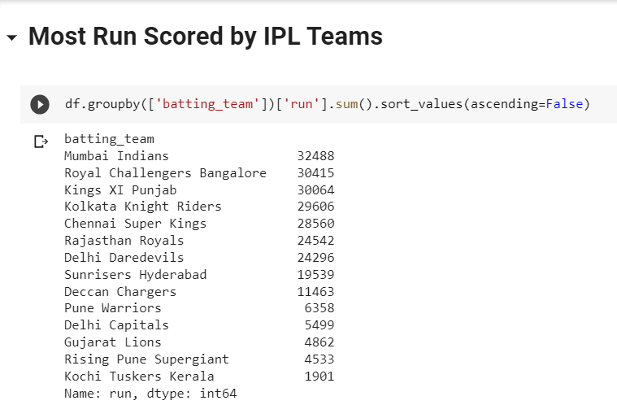
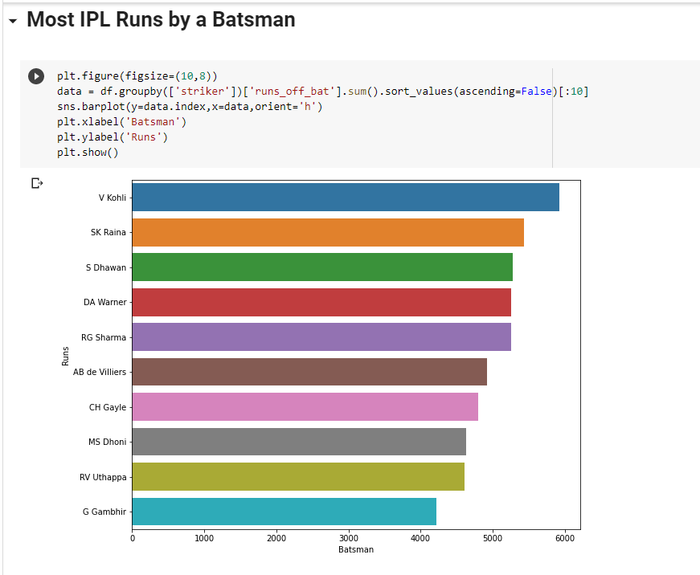
Code Snippets

Slide 11
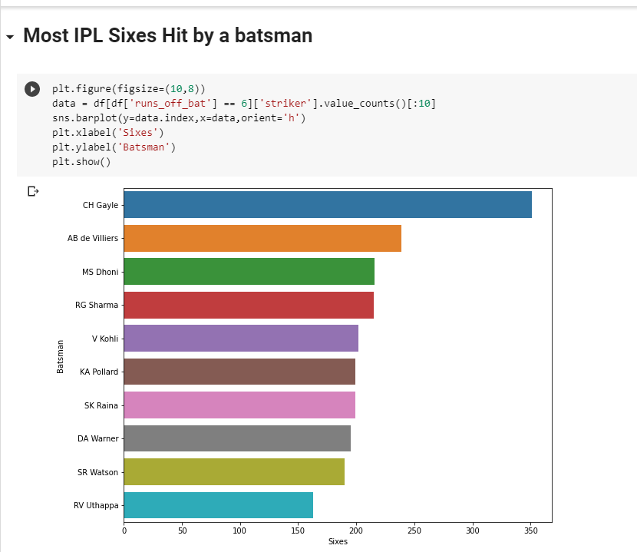
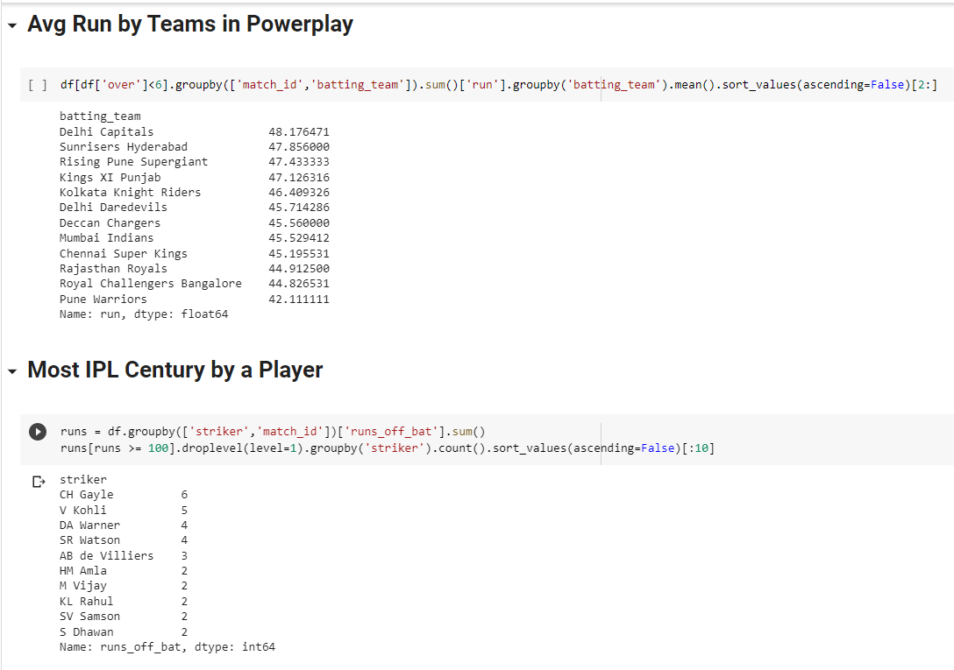

Slide 12
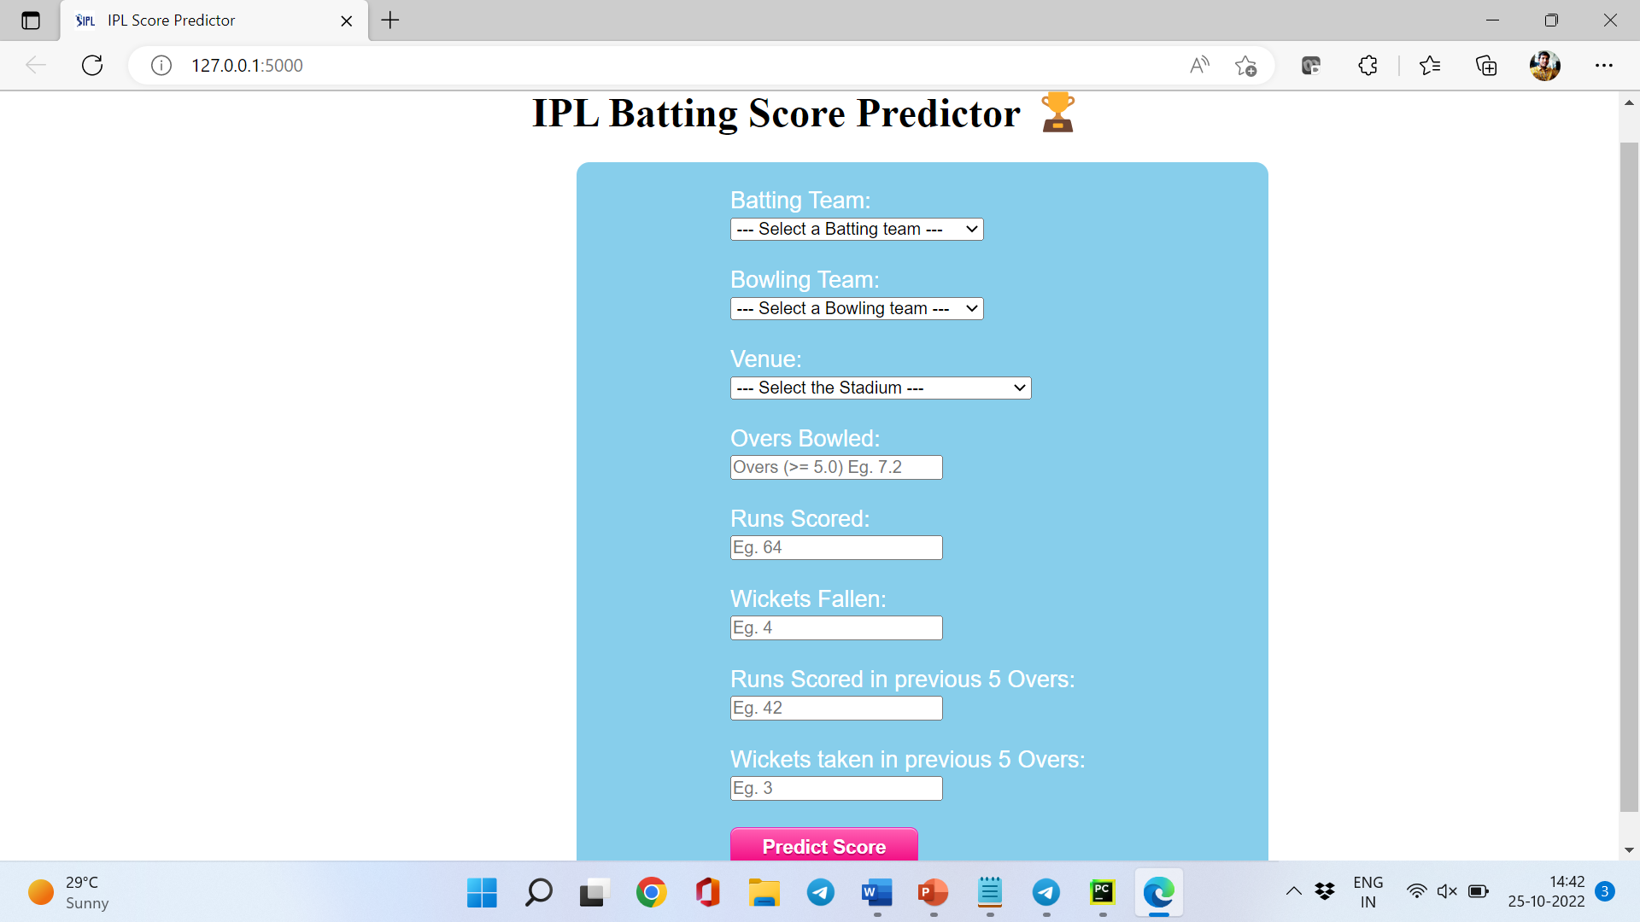

Slide 13
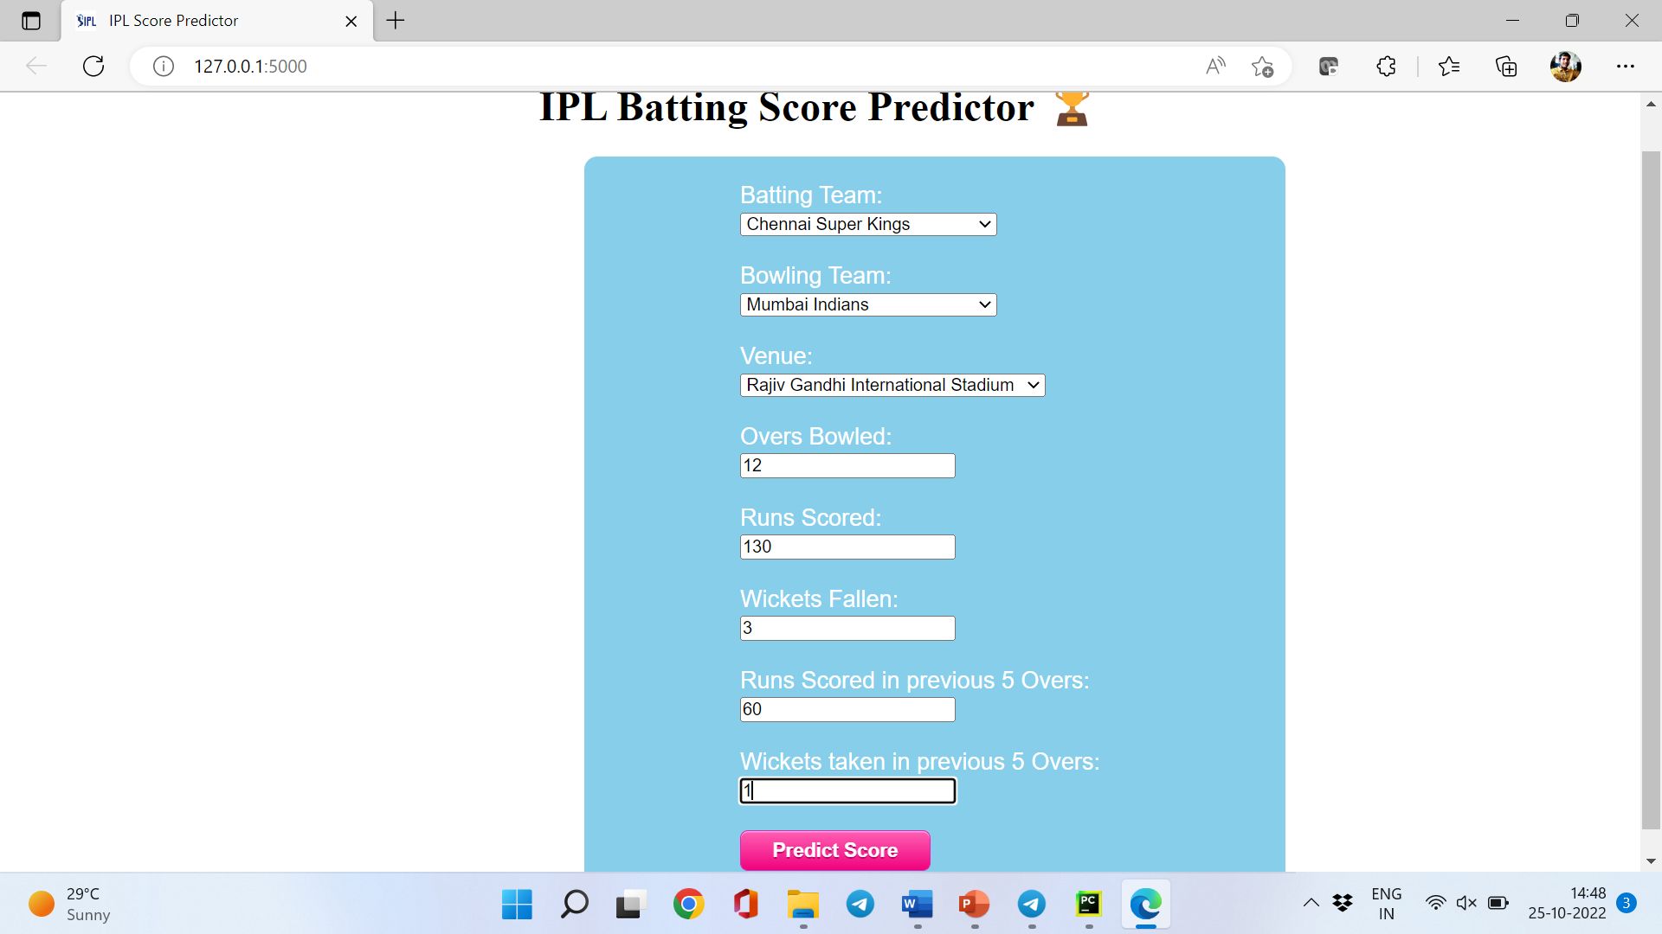

Slide 14
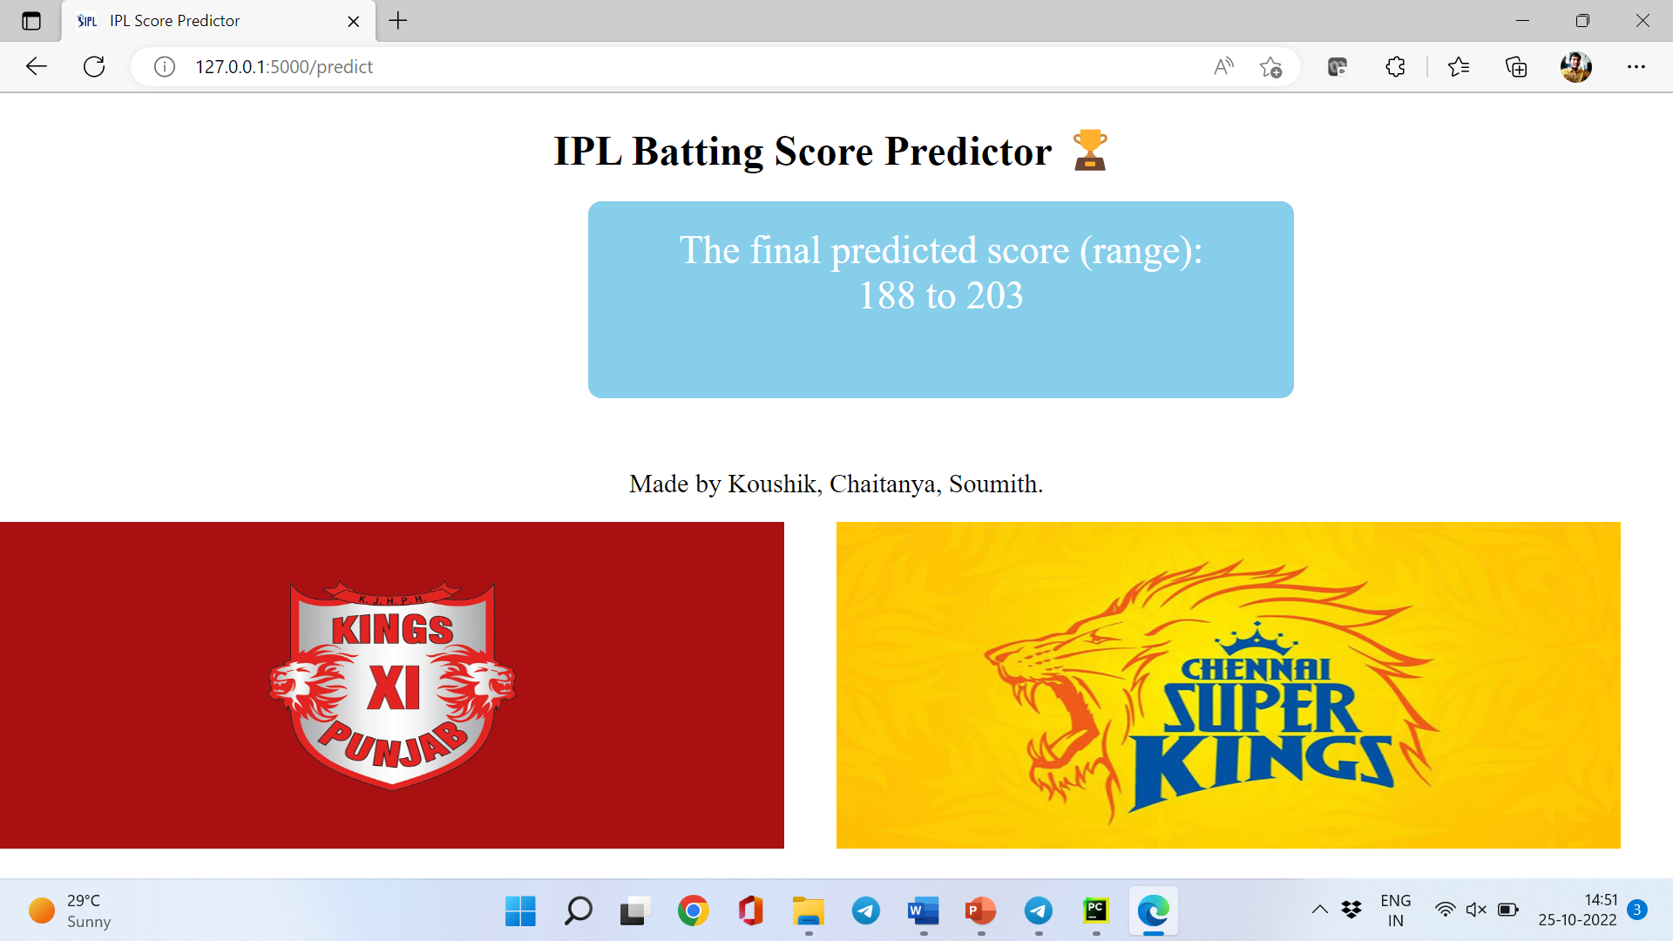

Slide 15
Conclusion
All this work aims at understanding the dataset of past 10 years history of the IPL data.
Selection of the best team for a match plays a major role for the team’s finish. The main goal of our is to analyse the IPL cricket data and predict the end score of a innings.

Slide 16

THANK YOU

